Slide 1
Sri Siddhartha Institute of Technology (A Constituent College of Sri Siddhartha Academy of Higher Education) Maralur, Tumakuru-572105 Project Seminar on “DESIGN AND IMPLEMENTATION OF DENSITY BASED DIGITAL FUEL LEVEL INDICATOR USING LOAD CELL AND TYRE PRESSURE INDICATOR”
PRESENTED BY
KARTHIK N D (14EC029)
KUMARA SWAMY V M (14EC033)
MOHAN B J (14EC412)
PRASHANTH C S (14EC050)
Under the guidance of
Prof. M C Chandrashekhar
Associate Professor, Dept. of ECE, SSIT, Tumakuru.

Slide 2
OUTLINE OF THE PRESENTATION
1. Introduction
2. Literature survey
5. System Design
6. Hardware And Software Requirements
7. System Implementation
8. Results
9. Advantages
10. Applications
11. Conclusion
12. References

Slide 3
INTRODUCTION
Accurate fuel measurement is not possible in the existing system.
The petrol bunks often use various methods of malpractices.
The proposed digital fuel indicator gives the exact amount of fuel added to the fuel tank.
The system also measures the tyre pressure and indicates if there is a low pressure in the tyres.

Slide 4
OBJECTIVE
Automated fuel measuring system that gives accurate amount of fuel added in the fuel bunks.
Measuring the tyre pressure and enabling a warning system if, it gets low.
MOTIVATION
To protect consumers from various forms of malpractice employed by the fuel bunks and to maintain the tyre pressure system to avoid accidents.

Slide 5
PROBLEM STATEMENT
People are cheated by a few petrol bunks by not filling proper quantity of fuel.
Fuel theft is a major concern for parked vehicles.
A tyre pressure monitoring system is required to warn the user about low tyre pressure.
PROBLEM SOLUTION
An accurate fuel measuring system is required.
A fuel theft warning system should be installed in a vehicle.
A constant tyre pressure monitor should be present in a vehicle. Along with a low pressure warning system.

Slide 6
LITERATURE SURVEY
PAPER NO | TITLE | AUTHOR NAME | DESCRIPTION
Paper -1 | “DRAG AND DROP: Data Transfer between Two Digital Devices” | Sachi Rana, Mr, Mohammed sayeemuddin Shaikh, Prof. Sanjay D Joshi.
Paper -2 | “A Step Towards Smart City Using Sixth Sense Technology” | Dr. A. Sumithra, K. Karthika, J. Jane Ida

Slide 7
Paper-3 | “A Study on Sixth Sense Technology” | Ajesh M.S., Subin P Sabu, Ms. Mintu Movi | This paper helps us to understand how the sixth sense device has overpowered the five natural senses. They also implemented an invisible computer mouse that enables interaction with computer without attaching a hardware mouse.
Paper-4 | “Design of Robotic Arm based on Hand Gesture Control System using Wireless Sensor Networks” | R.Raja Prabhu, R.Sreevidya | This paper focuses on design of a hand gesture control robotic arm using microcontroller with the help of zigbee and wireless sensor networks.
Paper-5 | “MATLAB based Gesture Controlled Robot” | Mukti Yadav, Mrinal Yadav, Hemant Sapra | This paper had proposed automatic gesture control using MATLAB which uses Bluetooth Module as a wireless medium through which PC and Robot are connected. Here two types of interfaces are created i.e. human PC interface and PC robot interface.

Slide 8
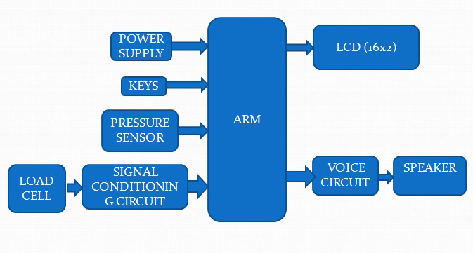
SYSTEM DESIGN
MAX
232
GSM MODULE
Figure no. 1: Block Diagram of The System

Slide 9
METHODOLOGY
In the proposed system, load cell is used to measure the amount of fuel present and the fuel added at a fuel station. The information obtained from the load cell is then processed by the ARM7 microcontroller.
The output is then shown in the LCD display. The system is also active when the vehicle is parked. If the load cell senses a rapid decrease in the amount of fuel present, the information is processed by the microcontroller and a warning is given through the speakers and the GSM Module.
A pressure sensor detects and calculates the tyre pressure with the help of the microcontroller. The output is then indicated in the LCD display, along with a warning if there is a low tyre pressure.

Slide 10
HARDWARE REQUIREMENTS
ARM7-LPC2148 Microcontroller
Load Cell
Alpha-Numeric LCD Display
Pressure Sensor
GSM module
Speaker Module
SOFTWARE REQUIREMENTS
Keil Vision 4

Slide 11
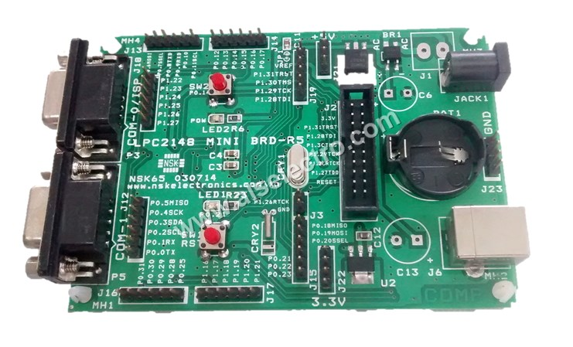
ARM7-LPC2148
Figure no. 2: ARM7-LPC2148 Micro-controller
16/32-bit ARM7TDMI-S microcontroller in a 64 pin package.
16 KB on-chip static RAM.
256 KB on-chip flash program memory.
In-System Programming (ISP).CPU operating voltage range of 1.65V to 1.95V (1.8V +/- 8.3%).
I/O power supply range of 3.0V to 3.6V (3.3V +/- 10%).
JTAG (Joint Test Action Group) support.

Slide 12
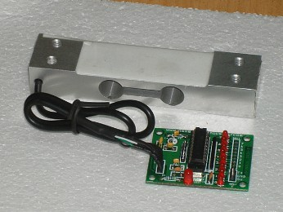
LOAD CELL
Figure no. 3: Load Cell
A load cell is a sensor or a transducer that converts a load or force acting on it into an electronic signal.
They are available in 5 kg to 150 kg capacities. Dimensions: 5.12" x 1.18" x 0.87" (130 mm x 30 mm x 22 mm).
Ready to interface with microcontrollers.
8 Bit Data o/p reference to load.
UART output.
Varies from 0- 255.

Slide 13
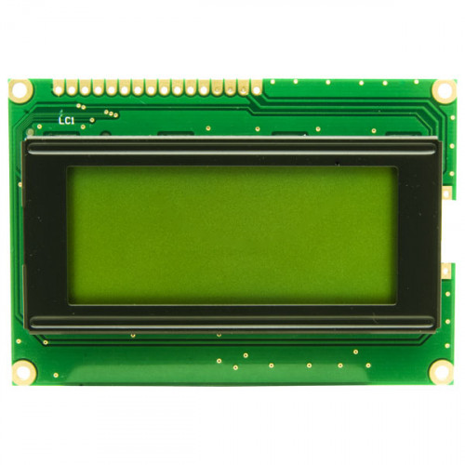
ALPHA-NUMERIC LCD DISPLAY
Figure no. 4: ALCD Display
A Liquid Crystal Display(LCD) shown in figure no. 4.3 is a thin, flat electronic visual display that uses the light modulating properties of liquid crystals (LCs). LCs does not emit light directly.
Display Format is 16 Character x 2 Line.
Input Data can be 4-Bits or 8-Bits interface available.
Display Font is 5 x 8 Dots.
Power Supply : Single Power Supply (5V±10%)

Slide 14
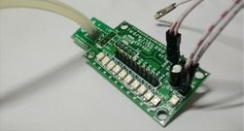
PRESSURE SENSOR
Figure no. 5: Pressure Sensor
The pressure sensors as the accuracy of 1%.
The standard output for pressure sensors is 4-20 mA.
High peak pressure resistance.
High alternating load resistance.
High long-term stability.

Slide 15
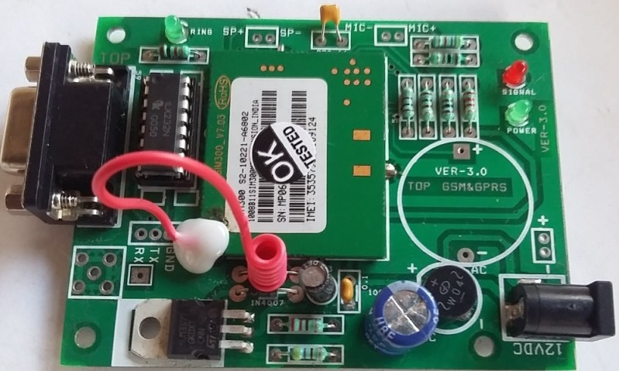
GSM MODULE
Figure no. 6: GSM Module
Dual-Band 900/ 1900 MHz
GPRS multi-slot class 10/8GPRS mobile station class B
Compliant to GSM phase 2/2+Class 4 (2 W @850/ 900 MHz)
Low power consumption: 1.5mA(sleep mode)
Operation temperature: -40°C to +85 °C

Slide 16
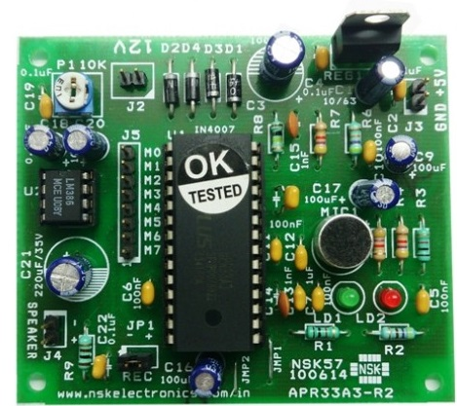
SPEAKER MODULE
Figure no. 7: Speaker Module
The APR33A3 device offers true single-chip voice recording.
non-volatile storage and playback capability for 40 to 60 seconds.
Ideal for use in portable voice recorders and speakers.
Advanced flash nonvolatile memory process, where each memory cell can store 256 voltage levels.

Slide 17
Keil Vision 4
Operating system: Windows 7
Compiler: Keil
Language used: C
Keil Software makes ANSI C compilers, macro assemblers, simulators, integrated environments, and evaluation boards for the 8051, 251, ARM7, and C16x/ST10 microcontroller families.
Keil development tools offer a complete development environment for ARM, Cortex-M, and Cortex-R processor based devices.
Keil software provides the ease of writing the code in either C or ASSEMBLY.
The new IDE from Keil Software combines Project management, Source Code Editing and Program Debugging in one powerful environment.

Slide 18
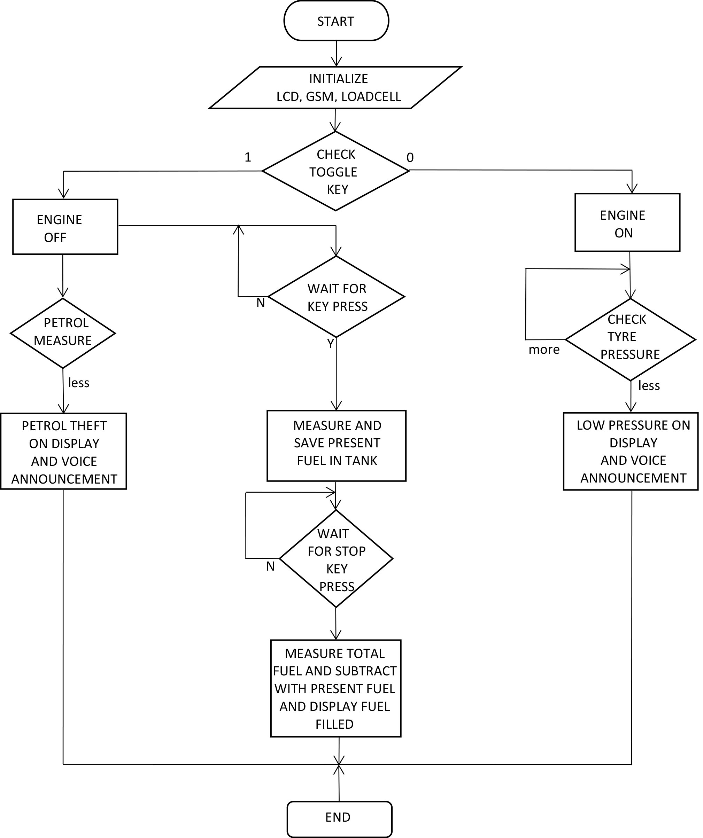
SYSTEM IMPLEMENTATION
Figure no. 8: Flowcart of The System

Slide 19
The pressing of reset button on the micro-controller, the LCD, GSM Module and Load Cell will be initialized. In the system, the toggle key is synonymous with the engine turned on and off.
A constant real time value of the fuel present within the fuel tank will be displayed on the LCD.
Process of filling fuel in fuel bunks.
When the toggle key is in on state, the system measures the tyre pressure. In the system, a threshold of 10 Pa has been set.
If the pressure is below that threshold, a speaker output, a message through GSM Module and a warning on the LCD will be displayed regarding low tyre pressure in the vehicle.
The system is programmed such that, the fuel theft detection will be activated only when the engine is off.
If there is a rapid descent in the amount of fuel present in the fuel tank, a fuel theft warning message is sent to the owner’s cellphone and is also displayed on the LCD.

Slide 20
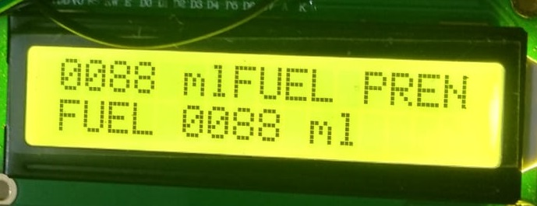
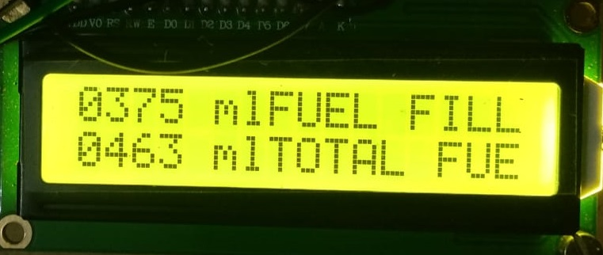
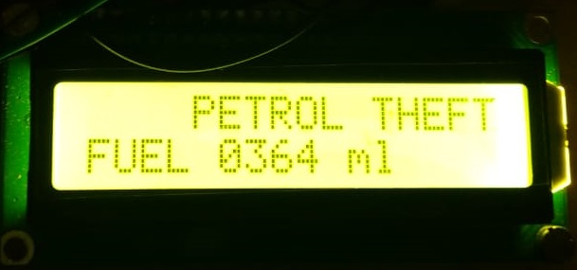
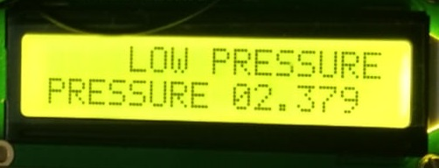
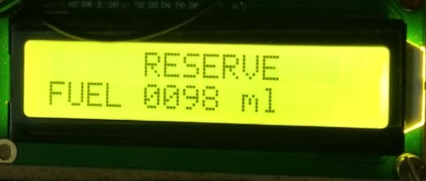
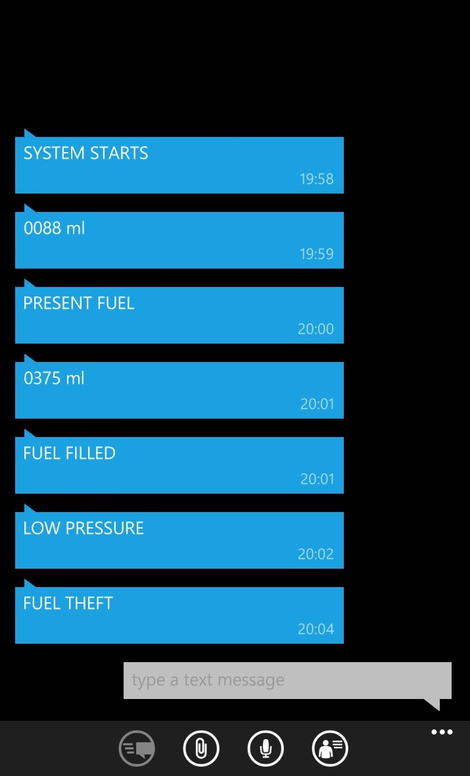
RESULTS
Figure no. 9: Present Fuel Record
Figure no. 10: Fuel Filled
Figure no. 11: Petrol Theft Warning
Figure no. 12: Low Pressure Warning
Figure no. 13: Reserve Warning
Figures 9 through 13 show various outputs displayed through LCD.
Fig. no. 14 shows the message outputs sent through the GSM Module.
Figure no. 14: Message outputs

Slide 21
ADVANTAGES
The implemented system can be used for
Accurate fuel measurement.
Real-time tyre pressure indication.
Fuel theft detection.

Slide 22
APPLICATIONS
The designed system can be implemented as a standardized fuel measurement system to all the vehicles.
The system is useful for fuel theft detection and real time tyre pressure indication.

Slide 23
CONCLUSION
The complete software and hardware implementation of the project has been completed.
The digital fuel level indicator is a very efficient way of getting real time value of the amoun of fuel present in the fuel tank.
It can be used to measure the amount of fuel added to the fuel tank and hence can be used to check the malpractices by the fuel bunks.
The tyre pressure measurement can be used to warn about low tyre pressure and to indicate accurate real time values.
Fuel theft detection can be implemented on vehicles to stop fuel theft from happening in the vehicles when parked.

Slide 24
REFERENCES
1. Suchita S. Kamble, Manisha Rinayat, Naina Tarpe, Priyanka Gadewar, Ganesh Barde, Aksahy Mohurle, “A Review: GSM Based Vehicle Fuel Monitoring and Theft Detection System with SMS Indication” June 2006, International Journal on Recent and Innovation Trends in Computing and Communication Volume: 5 Issue 1, ISSN-2321-8169.
2. Raveena A, Deepa R, “Fuel Measurement Using Loadcell” Oct 2017, International Research Journal of Engineering and Technology, ISSN-2395-0056.
3. Vishal H. Gahlot, Abhishek S. Narkar, Dhyan, Asst. Prof. Kavita Joshi, “Automated Fuel Measurement For Vehicles” 2016, IJARIIE Vol-2 Issue-2, ISSN(O)-2395-4396.
4. Jitendra Tamang, Naomi Somer Lepcha, Tshering Sangmo Sherpa, “GSM Based Fuel Theft Detector Using Microcontroller” January 2015, International Journal of Advance Electrical and Electronics Engineering, Volume-4, Issue-3, ISSN-2278-8948.
5. Jacek Caban, PawełDrozdziel, Daliborbarta, Štefanliscak, “Vehicle Tyre Pressure Monitoring Systems” Diagnostyka, Vol. 15, No. 3, 2014.
6. S.Mohanasundaram, P.Manikandan, “Design and Implementation of Load Cell Based Fuel Level Measurement” 2014, ICCCI-2014.
7. Anirudha Mule, UjwalPatil, AnilMore, S.R.Kale, “Study of Digital Fuel Meter and Fuel Theft Detection” March 2016, International Journal of Innovative research in Science and Engineering, Vol no. 2, Issue no. 3
8. Dinesh V. Rojatkar, Nikhil G. Yerojwar, Gitesh V. Mudey, Shamseer Raza, Janabai Pawar, “16x2 Alpha-Numeric Liquid Crystal Display” International Journal For Engineering Applications And Technology, ISSN: 2321-8134.

Slide 25
THANK YOU

